Slide 1
January 19, 2017
Lender Panel: State of the Market 2017

Slide 2
Panel Participants
John Lundberg
  PNC Bank – Senior Vice President & Senior Business Development Officer
Jonathan Smith
  First National of Denver – Executive Vice President
Steven Ogus
  Wells Fargo Capital Finance – Senior Vice President/Business Development
Moderated by Greg L’Herault
  First Business Capital Corp – Vice President and Business Development Officer

Slide 3
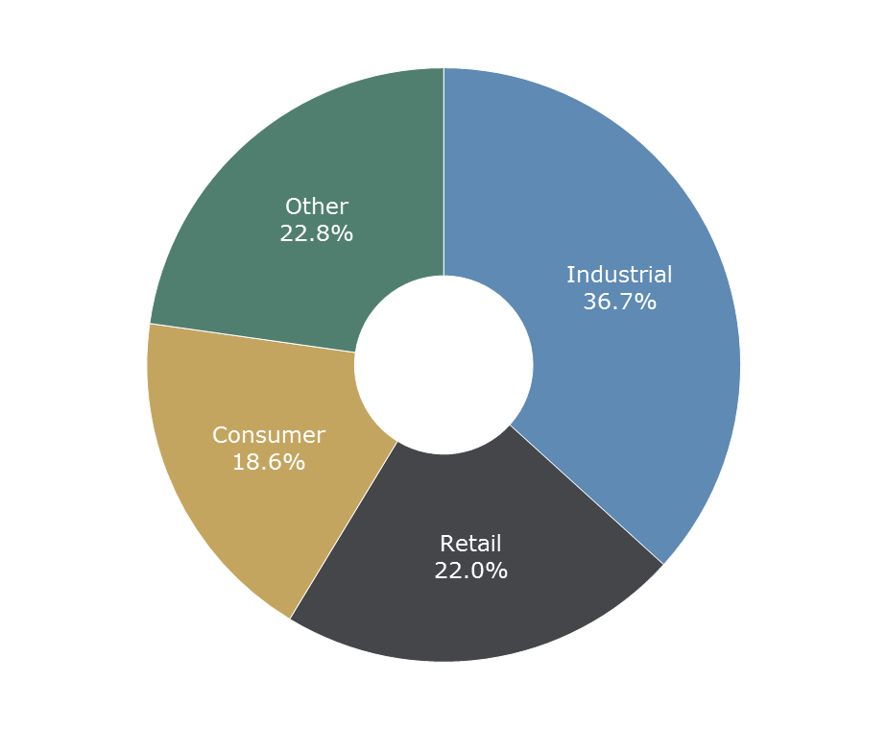






Wells Fargo Capital Finance - Asset-Based Lending
Wells Fargo is a leading arranger of syndicated asset-based loans
Wells Fargo Capital Finance is the largest asset-based platform in the industry with $79 billion in total commitments to ~1,500 clients
1-3Q16 Asset-Based Bookrunner League Table
Wells Fargo Portfolio Breakdown
$79
billion
Select Closed Transactions
$3.7 Billion
Senior Secured Revolver
•
Left Lead Arranger
Syndication Agent
$2.35 Billion
Senior Secured Revolver
•
Left Lead Arranger
Administrative Agent
$1.6 Billion
Senior Secured Revolver
•
Left Lead Arranger
Administrative Agent
$1.0 Billion
Senior Secured Revolver
•
Left Lead Arranger
Administrative Agent
$850 Million
Senior Secured Revolver
•
Left Lead Arranger
Administrative Agent
$700 Million
Senior Secured Revolver
•
Left Lead Arranger
Administrative Agent
¹ Includes syndicated transactions ≥$100 million

Slide 4
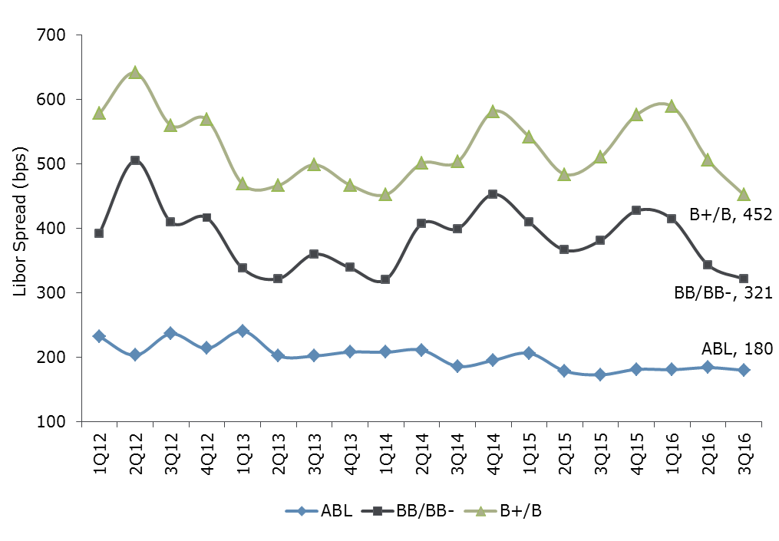
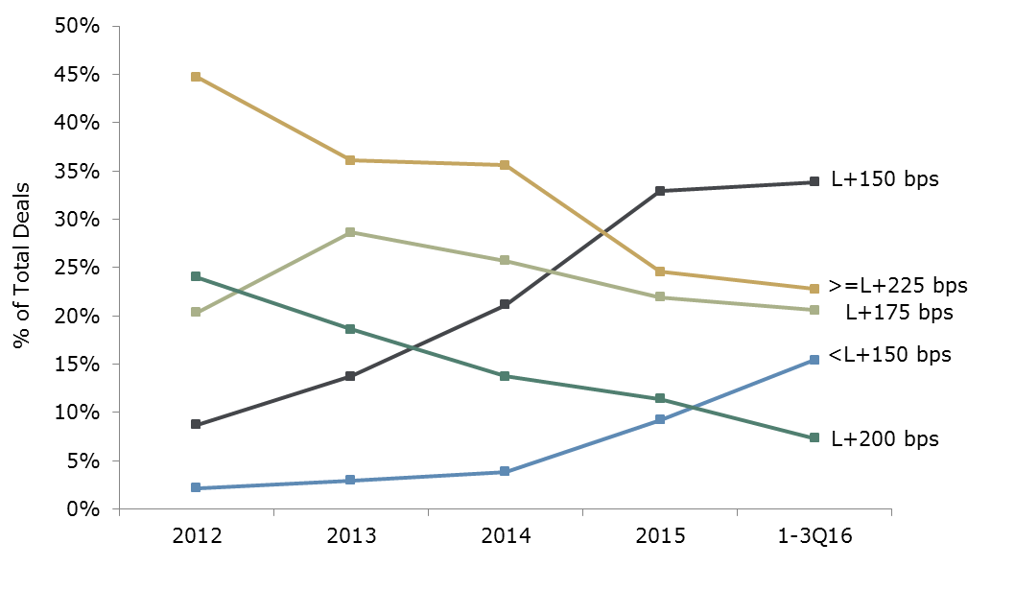
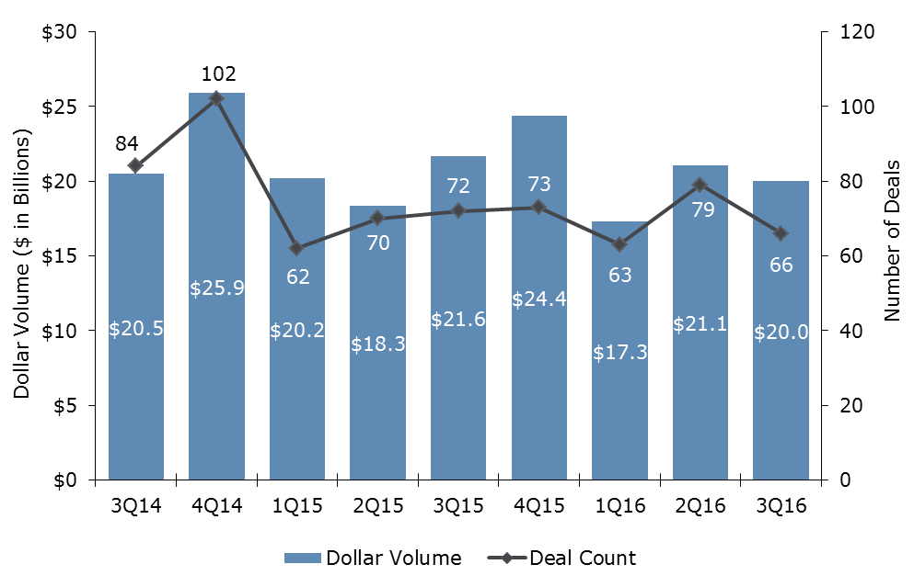
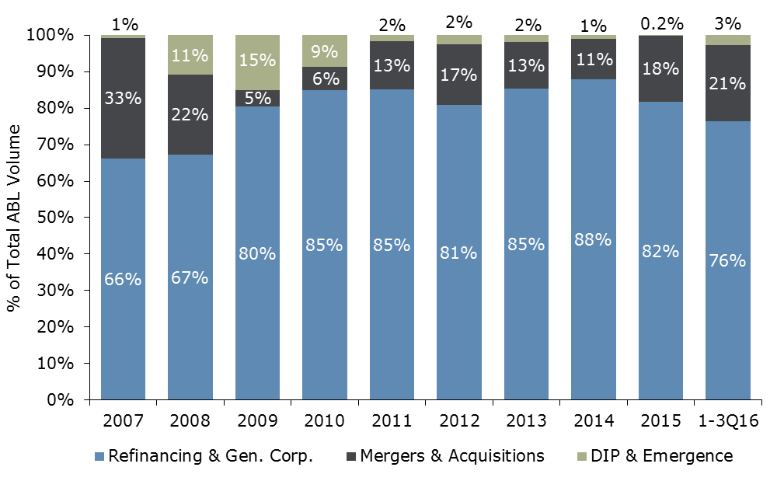
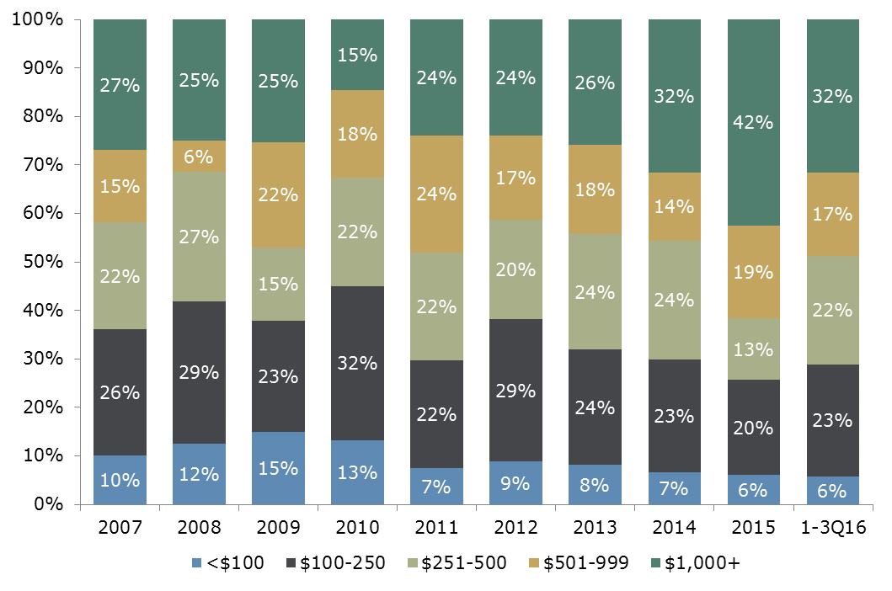
Asset-Based Market Overview – Large Cap
The asset-based market remained a stable source of capital through
Q3 of 2016 as spreads continue to hover near historic lows
ABL vs Cash Flow Pricing
Pricing Frequency
Observations
Through Q3, volume and number of deals were flat compared to the same period in 2015. The institutional loan and high yield markets continued to show strength and a number of ABL transactions with concurrent financings were completed.
The market has been principally driven by refinancing activity, however M&A volume is at its highest level since the 2008 market correction.
Spreads and fees are near historic lows. However, banks are hyper focused on loan and relationship returns, making ancillary economics an important consideration for lenders at all levels of the syndicate.
Arrangers have shown a willingness to push the boundaries on many structural terms including advance rates, trigger levels, and negative covenants for clients with strong credit profiles.
Note: ABL data represents syndicated transactions >$100 million. BB/BB- and B+/B pricing represents all-in yield including the benefit of LIBOR floor and OID.
Source: Thomson Reuters, S&P & Wells Fargo
Note: ABL pricing data represents syndicated transactions >$100 million.
Source: Thomson Reuters, S&P & Wells Fargo
Asset-Based Volume
Purpose by % of Dollar Volume
Deal Size as % of Dollar Volume
Source: Thomson Reuters
Source: Thomson Reuters & Wells Fargo
Note: $ in millions.
Source: Thomson Reuters & Wells Fargo

Slide 5
Asset-Based Market Overview – Large Cap
Market Commentary
Volume
While full year 2016 asset-based volume of $75.8B represents a 10% drop from 2015;, the number of closed transactions was up slightly over 2015.
Transactions over $1.0 billion were down almost 50% , attributing to the overall dip in volume.
Refinancing remains the primary driver of asset-based volume, representing over 80% of total volume in 2016.
Looking forward, too early to tell with new administration as to what will happen with GDP growth as well as the regulatory environment (Dodd-Frank) and the impact to asset-based volume.
Pricing
Competitive pressure among arrangers has kept drawn spreads near 2007 lows, with the majority of deals opening in the L+150-175 bps range. However, in Q4 spreads were stable, edging slightly higher.
Asset-based pricing continues to compare favorably to pro rata cash flow pricing, especially for single B issuers.
Unused fees typically range from 25-37.5 bps, depending on the level of usage.
Upfront fees are averaging 20-30 bps on new transactions, though 1-2 year extensions are often executed with discounted fees.
Structure
While current asset advance rates have remained relatively stable over the past few years, there has been increased inclusion of foreign collateral, M&E and real estate in borrowing bases.
Cash dominion and covenant testing excess availability triggers are typically 12.5-15% of the facility, although some transactions have tested the market with triggers of 10%.
Asset-based lenders remain comfortable with the covenant-lite concept .
Syndication Dynamics
The number of active asset-based investors is more than adequate for current deal flow and has likely reached a plateau for the near term. Recent new entrants are mostly small regional U.S. banks.
Limited appetite for unfunded, non-relationship deals requires more reliance on top tier banks and relationship banks with ancillary income.
Lenders have digested regulators’ leveraged lending guidance; however, criticized assets and those with the potential for downgrade are receiving significantly more attention during the underwriting process.

Slide 6
Asset-Based Market Overview – WFCF Middle Market ($5MM-$35MM LOC)
Market Commentary
Volume
2016 volume was down slightly from 2015 but significantly down from historical average.
Refinancing remains the primary driver of volume, representing around 85% of total volume in 2016. M&A remains muted in the ABL space, but appears to be gaining some momentum. May be impacted by new administration
Bank balance sheets are generally still clean, although there has been some stress due primarily to commodity challenges and energy, Traditional banks/regional banks remain extremely aggressive in the ABL-lite space.
Volume also impacted by deals falling out of due diligence due to poor financial performance, collateral shortfalls (audits & appraisals) and a myriad of background check issues.
Pricing
A number of new competitors has created overall yield compression. However, yields have appeared to hit bottom.
Risk/return profile is very much out of balance. Not much more room to go down for most institutions.
increasing interest rate environment would be helpful on multiple levels
Average upfront fees were down again in the past year due primarily to the refinance nature of the market
Unused fees down slightly, but not materially overall
Structure
While current asset advance rates have remained relatively stable over the past few years, there has been increased inclusion of foreign collateral, M&E and real estate in borrowing bases.
Cash dominion and covenant testing excess availability triggers have moved into the middle market as well.
Leverage Lending policy less of an issue in Middle Market due to lower likelihood of multi-tranches of debt.
Restructuring opportunities increased slightly but do require a higher level of liquidity to affect refinance.
Portfolio Activity
Runoff (within WFCF) primarily attributable to a sale or some liquidity event.
Existing customer extensions are often executed with discounted fees.
Overall portfolio pretty clean with limited problem loans.

Slide 7

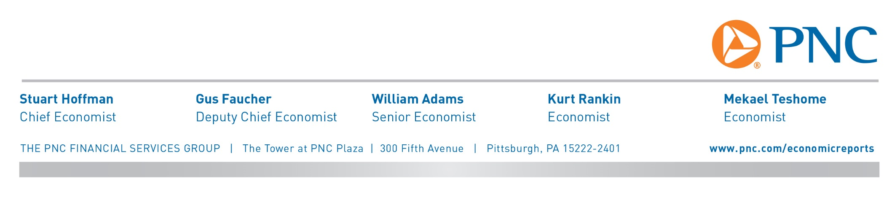
US ECONOMIC OUTLOOK
POST-ELECTION REFLATION
Slides Prepared by PNC Economics
January 17, 2017

Slide 8
PNC Economics forecasts faster growth and a tighter job market in 2017 & 2018
Sources: Moody’s Analytics, The PNC Financial Services Group; Forecasts are reproduced from PNC Economics’ January 2017 baseline forecasts

Slide 9
Business capital spending looks set to improve as the drag from lower oil prices fades
Sources: Moody’s Analytics, PNC Economics’ January 2017 Baseline Forecasts

Slide 10
faster growth and a tighter job market are a recipe for higher interest rates
Sources: Moody’s Analytics, PNC Economics’ January 2017 Baseline Forecasts

Slide 11
Thanks for sharing your day with us
For more PNC economic forecasts, visit us at
www.pnc.com/economicreports
And for investment strategy insights, at
https://www.pnc.com/en/personal-banking/wealth-management/investment-corner/Investment-Corner.html
Disclaimer: The material presented is of a general nature and does not constitute the provision of investment or economic advice to any person, or a recommendation to buy or sell any security or adopt any investment strategy. Opinions and forecasts expressed herein are subject to change without notice. Relevant information was obtained from sources deemed reliable. Such information is not guaranteed as to its accuracy. You should seek the advice of an investment professional to tailor a financial plan to your particular needs.
© 2017 The PNC Financial Services Group, Inc. All rights reserved.

Slide 12
Large Banks’ Asset Market Share Has Dramatically Increased
- and there are 238 fewer Banks than last year
Banks > $10bn: 37%
Banks > $10bn: 81%
Source: SNL Financial. Includes public and private commercial and savings banks.

Slide 13
Number of Banks by Asset Size
60% of <$500MM Banks are gone
 | Count as of 1990 YE | Count as of 2016 Q3
<$500mm | 12,061 | 4,624
$500mm - $1bn | 309 | 754
$1.0bn - $2.5bn | 204 | 381
$2.5bn - $5.0bn | 108 | 137
$5.0bn - $10.0bn | 67 | 82
$10.0bn - $50.0bn | 47 | 72
>$50.0bn | 8 | 38
Total | 12,798 | 6,088
Small banks have been acquired by or merged into mid-size banks, while mid-size banks have grown and migrated to large-bank status.
Source: SNL Financial. Includes public and private commercial and savings banks.
Notes:
1,440 failed, 19 assisted transactions = 1,459 total

Slide 14
Bank Performance by Asset Size
- Mid-size Banks are the most profitable at this point in the Cycle
ROAE
Source: SNL Financial. Includes public and private commercial and savings banks.
Notes:
Large banks ROE has dropped so dramatically due to NIM compression and reduced leverage (increased leverage ratio).

Slide 15
Commercial Loan Growth for Community & Small Regional Banks Has Surpassed Pre-Recession Levels
Source: SNL Financial

Slide 16
Slight Improvement in Net Interest Margin in 2016, Yet Still Well Below 27-Year Average
Source: SNL Financial

Slide 17
Economic Expansion continues….for how long??
- Average expansion period has doubled since 1982

Slide 18
Denver continues its upward trajectory
- young, well educated and healthy

Slide 19
Fort Collins leads the way, but Colorado leads the USA
- +/- 3.5% unemployment rate

Slide 20
Online Sales expected to grow 56% by 2020 to $565Billion
- Amazon sales are currently at $203,000 per minute
- Zero New enclosed malls built in the last 11 years
- As many as 100 enclosed malls expected to close in the next 5 years
- The new RH in Cherry Creek Mall

Slide 21
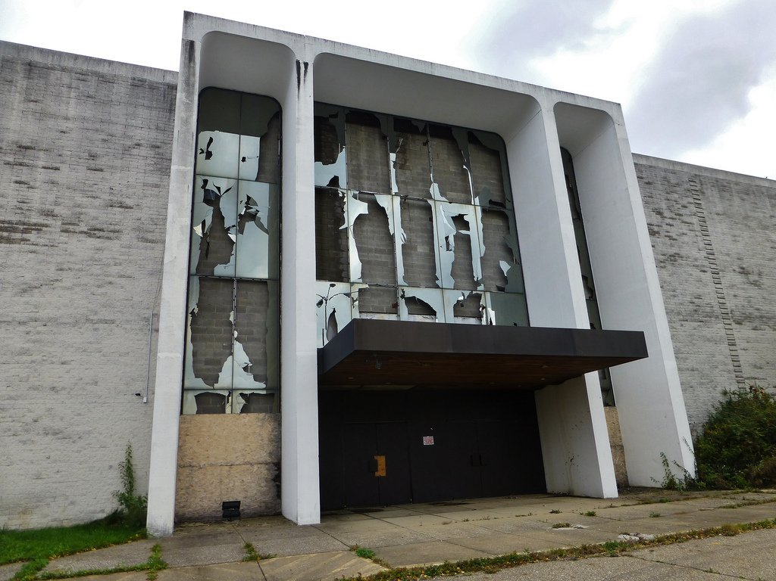
Need to shed over 800 underperforming stores
Former Macy’s Store

Slide 22
Coal production is a Double Black at Vail
- as Natural Gas continues huge growth

Slide 23

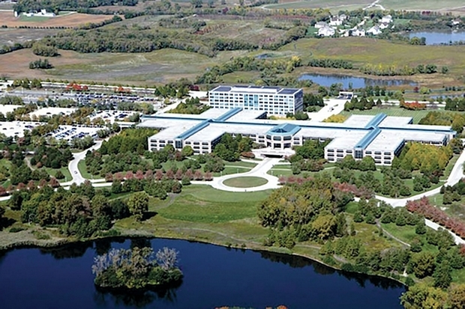
Suburban office campuses are becoming dinosaurs
- millennials have little interest in the suburbs
New Google Offices in a 1912 West Loop
Office building in Chicago
Former AT&T 1.6MM square foot
Suburban Chicago campus in $132MM
CMBS foreclosure – 100% vacant

Slide 24
The Trump Effect
Dodd-Frank
Interest Rates
Taxes
Healthcare
International Trade
??????????

Slide 25
Panel Participants
John Lundberg
  PNC Bank – Senior Vice President & Senior Business Development Officer
Jonathan Smith
  First National of Denver – Executive Vice President
Steven Ogus
  Wells Fargo Capital Finance – Senior Vice President/Business Development
Moderated by Greg L’Herault
  First Business Capital Corp – Vice President and Business Development Officer

